Slide 1
Narrative links
How can an object help us to narrate the past?

Slide 2
Narative links
Preparation:
Print and cut up the set of 12 Photograph sorting cards along the dotted lines, collecting the cards together to create one set for a group of 4 students.
Print and cut up the set of 6 Survivors describe similar experiences cards along the dotted lines, collecting the cards together to create one set for a group of 4 students.
Print out the slide Order in which the links are soldered – one per pair of students

Slide 3
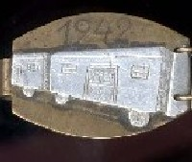
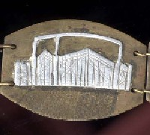
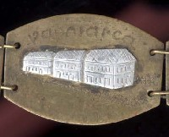
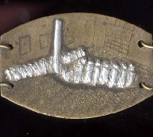
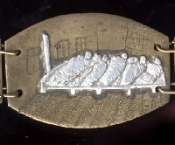
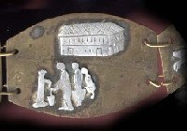
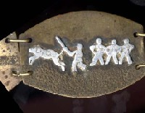
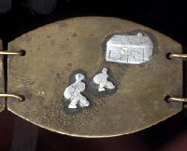
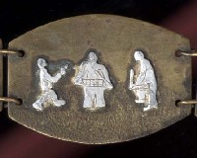
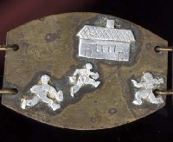
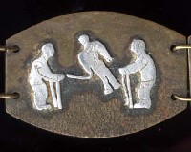
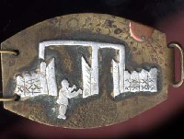
Photograph sorting cards

Slide 4
Survivors describe similar experiences cards
The railroad cars, they just had little windows on the top. Barred with barbed-wire. There were maybe two windows on top and they packed the whole car with people so it was unbelievably hot and stuffy. You couldn’t hardly breathe. Hundreds of people they shoved in the wagon...like cattle cars, but they were not open. It would be good if they were open but they were closed...a lot of people never came out of those wagons...they were dead...I was young and strong and I think that’s why I survived, you know, a lot of people didn’t...
Joseph Aleksander, survivor
Horse stables and they converted them into barracks to live...quite a few hundred people in the barrack... Henry Goteiner, survivor
...and in each one – six girls – women, but it was so tight that three of us went with the head to one side and three of us with the head to the other side, to be just like the sardines. When you open a can of sardines, you see how they are packed in. It’s how we were packed in. If any one of us had to turn around at night – all six had to turn around ‘cause there was not enough room between us...
Ruth Brand, survivor
Every morning we had to go to the appell, appell meant that we had to be present in the square in the camp so that they could count us. I remember that was an ordeal because you had to stand up for long, long hours in the cold...
Flora Carasso Mihael, survivor

Slide 5
I couldn’t eat. I stopped eating. Only wanted water, water. But who could get the water. Somebody came by with a bucket of water, everybody was grabbing, so half was going to waste, ‘cause everybody wanted water. It was so hot. This was a horrible time...
Rose Kohn, survivor
I was in Westerbork, I was once on my own, I came around the corner and I came face to face with two guards with two German guards and one of them had an Alsatian which set about me, and bit me on the arm, and I was absolutely petrified and they just laughed and then they pulled the dog off and I remember running back with a bleeding arm.
Steven Frank, survivor

Slide 6
Order in which the links are soldered
1
2
3
4
5
6
7
8
9
10
11
12

Slide 7
Narrative links

